Slide 1
Chapter 0:
Introduction
Data Structures in Java: From Abstract Data Types to the Java Collections Framework
by Simon Gray

Slide 2
Introduction
This chapter offers a quick introduction to many of the concepts that are presented in greater depth throughout the rest of the text
What you should look for:
  Terminology: learn to use vocabulary of object-oriented programming and the “container” types
  Relationships: begin to get a feel for how the terms and concepts are related to one another

Slide 3
Abstraction
A tool to manage complexity
Hide irrelevant details; focus on the features needed to use a thing
Examples
  File deletion using icons
  The brakes on a car
  Television remote
  What else?

Slide 4
Data Type
Specification View of a data type
  Data values
  Operations defined on those values
  Abstract Data Type (ADT) – note use of abstraction!
Implementation View of a data type
  Language-specific representation for the values
  Implementation of the operations
  ⇒ Implementation of an ADT

Slide 5
Algorithm
A finite sequence of steps that solves a well-defined problem
Algorithm development (have a plan!):
Specification ⇒ Pseudocode ⇒ Implementation ⇒ Test
ADT “operations” are algorithms
Algorithm “cost” – a basis for evaluating and comparing algorithms
  Time complexity
  Space complexity

Slide 6
Object–Oriented Programming
Model the structure and behavior of a system through the interaction of software objects that represent entities from the problem domain
  Intuitively, the model “looks” and “behaves” like the system in the problem domain
Class ⇒ Data Type
  Data fields ⇒Values
  Methods ⇒ Operations
Information hiding
  Reveal only those methods you want a client to see ⇒ API
  Hide implementation details
⇒ abstraction (again)!

Slide 7
Code Reuse: Classes
Inheritance defines an “is a kind of” relationship between child/subclass and parent/superclass
  A TemperatureMonitor “is a kind of” Monitor
  A subclass inherits capabilities from its superclass
Composition defines a “has a” relationship
  A BankAccount “has a” String field to store the client’s name; an Address field to store the client’s address, etc.
  One class has (is composed of) one or more other classes

Slide 8
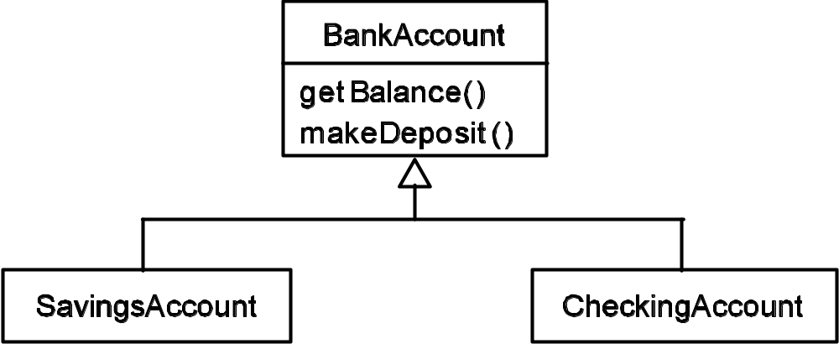
Inheritance Example
UML Class Diagram
SavingsAccount and CheckingAccount are kinds of BankAccount. Where is the code reuse? SavingsAccount and CheckingAccount inherit the getBalance() and makeDeposit() methods from BankAccount

Slide 9
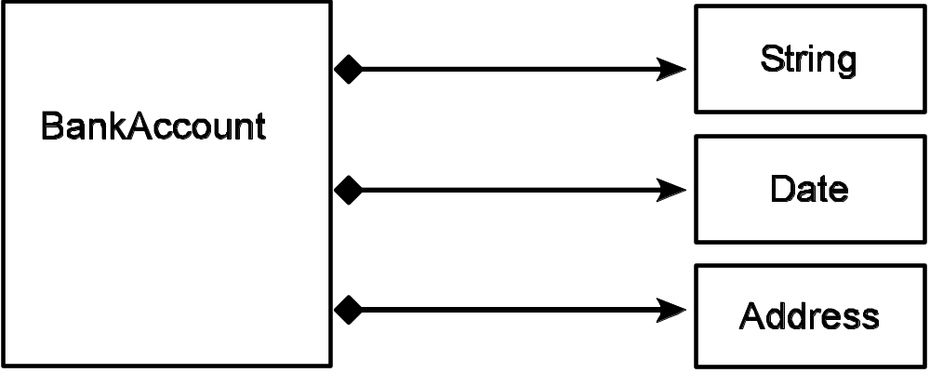
Composition Example
_{A BankAccount can have a}
• String field to store the client’s name
• Date field to store the account’s creation date
• Address field to store the client’s address
UML Class Diagram

Slide 10
Unified Modeling Language (UML)
A visual notation to describe the components of a system and their relationships
Class diagram: a static picture of some of the classes in a system and their relationships to one another
Object diagram: a snapshot of some objects in the system showing their values and relationships to other objects
Sequence diagram: shows the sequence of method calls needed to solve a problem (an algorithm)

Slide 11
Code Reuse: Methods
A type-specific method is tied to a single type
  If you want to support more than one type, you need another instance of the method specific for that type
A generic method is not tied to a single type
  To apply the method to a different type provide that type through a type argument (type parameter)

Slide 12
Generic Methods: An Example
Listing 0.1 A swap() method to swap Rational objects in an array.
1 void swap( Rational[] theArray, int i, int j ) {
2 Rational t = theArray[i];
3 theArray[i] = theArray[j];
4 theArray[j] = t;
5 }
Listing 0.2 A generic swap() method for an array.
1 <T> void swap( T[] theArray, int i, int j ) {
2 T t = theArray[i];
3 theArray[i] = theArray[j];
4 theArray[j] = t;
5 }
Note the red entries!

Slide 13
Software Life Cycle
Analysis and Specification
Design
Implementation
Testing and Debugging
Maintenance

Slide 14
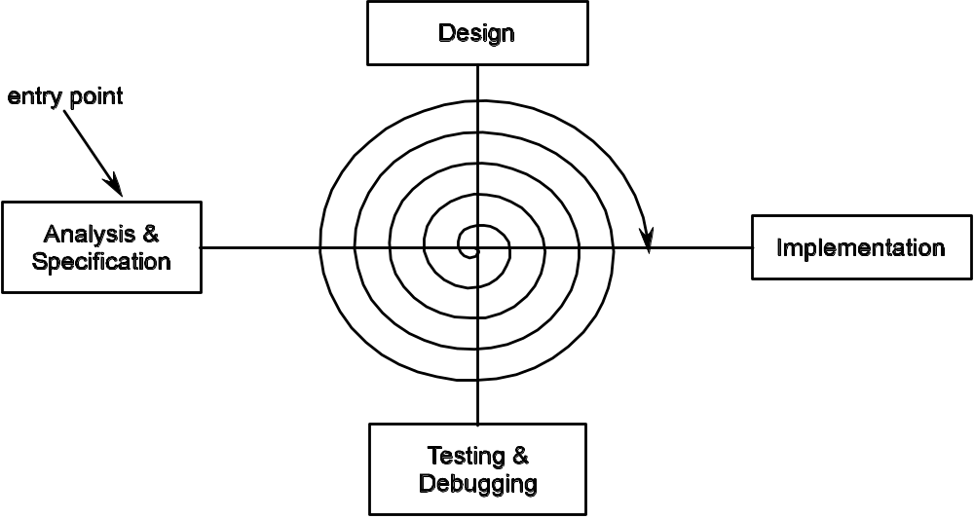
Spiral/Incremental Model

Slide 15
Software Testing
So…how do you know your solution is “correct”?
Proofs of correctness are difficult, so we rely on testing
When to test?
  After the analysis and design are complete. The design should be critically examined within the context of the problem to be solved. Does it look like the proposed solution will solve the problem?
  During the implementation. As code is completed, its correctness should be tested. This is called verification and helps catch problems early and gives you confidence that you are building on a solid code foundation.
  After the implementation is complete. The components should work together as expected and the completed system should meet the client’s needs.

Slide 16
Idea Reuse: Software Design Patterns
An abstraction of a software solution to a commonly encountered software engineering problem
Avoid reinventing the wheel – adapt a known solution (pattern) to a well-known problem
Software pattern components: name, context, outline, consequences

Slide 17
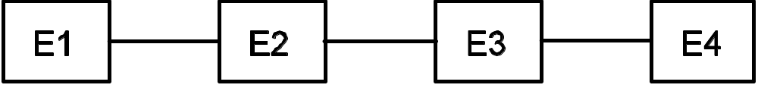
Collection Categories
Linear Collections
  List
  Stack
  Queue
Notes:
“Collections” are also called “containers”.

Slide 18
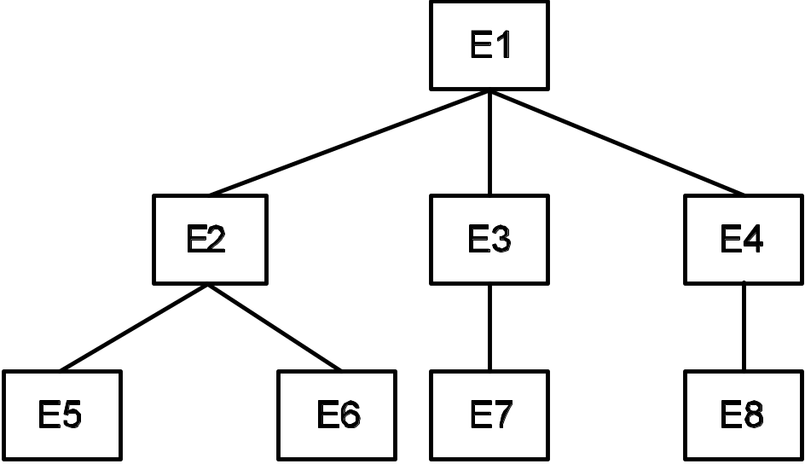
Collection Categories
Hierarchical Collections
  Tree
  Binary Tree
  Binary Search tree

Slide 19
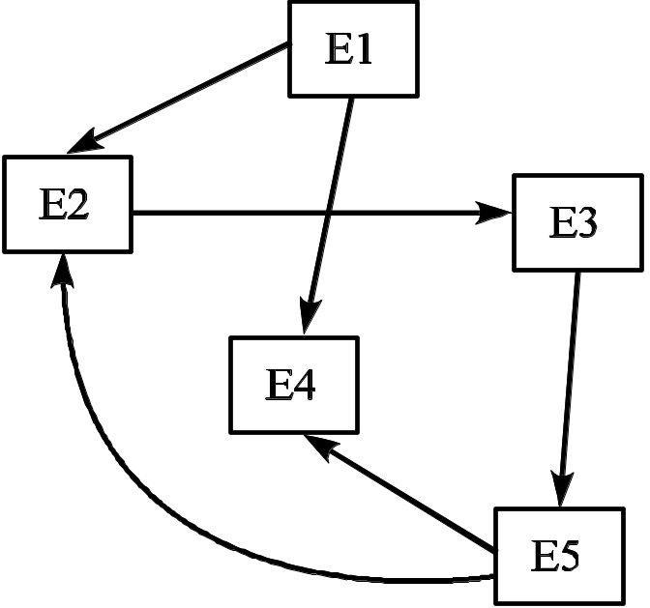
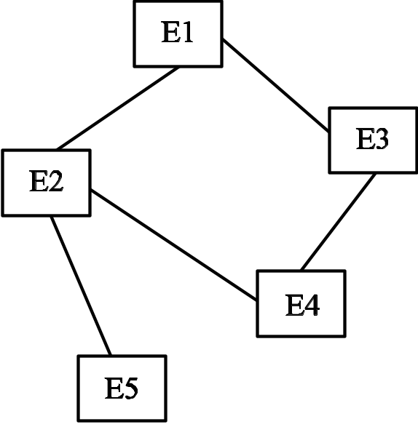
Collection Categories
Graph Collections

Slide 20
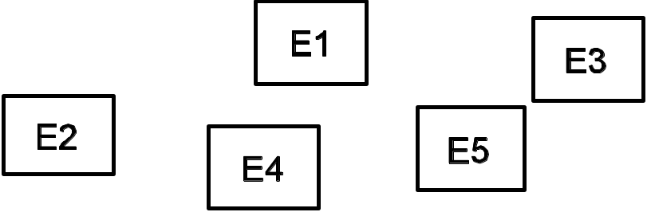
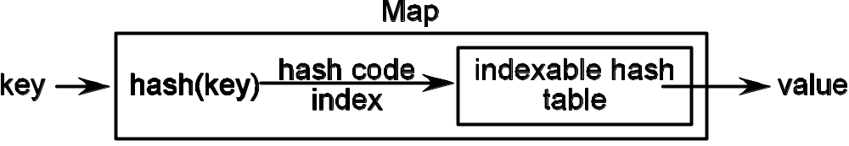
Collection Categories
Nonpositional Collections
  Collection
  Map

Slide 21
Collection Operations
Most collections support the same operations, but may give
them different names.
Add an element
Remove an element
Replace an element
Retrieve an element
Determine if a collection contains an element
Get the collection’s size
Determine if a collection is empty
Traverse a collection
Determine if two collections are equal
Clone a collection
Serialize a collection

Slide 22
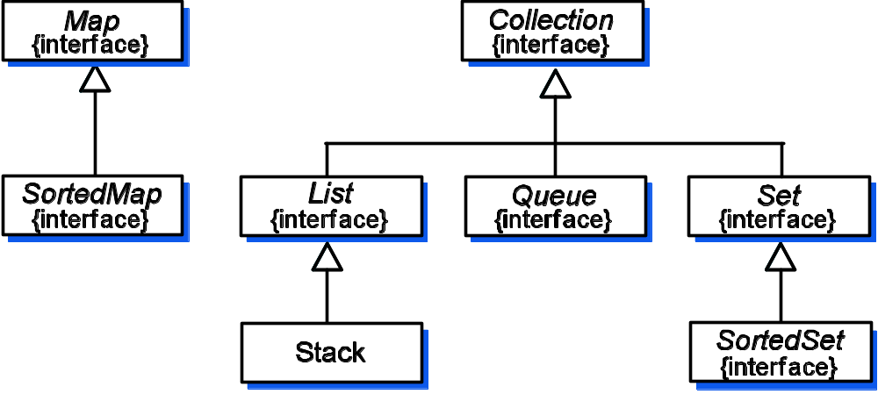
The Java Collections Framework (JCF)
UML Class Diagram

